Slide 1
AI in Healthcare: Lecture 2

Slide 2
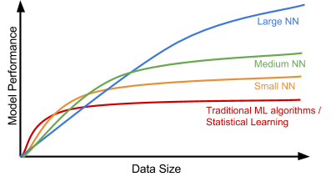
Why is Deep Learning taking off

Slide 3

Reminder: Computer Vision
Processing on Image/Video data

Slide 4
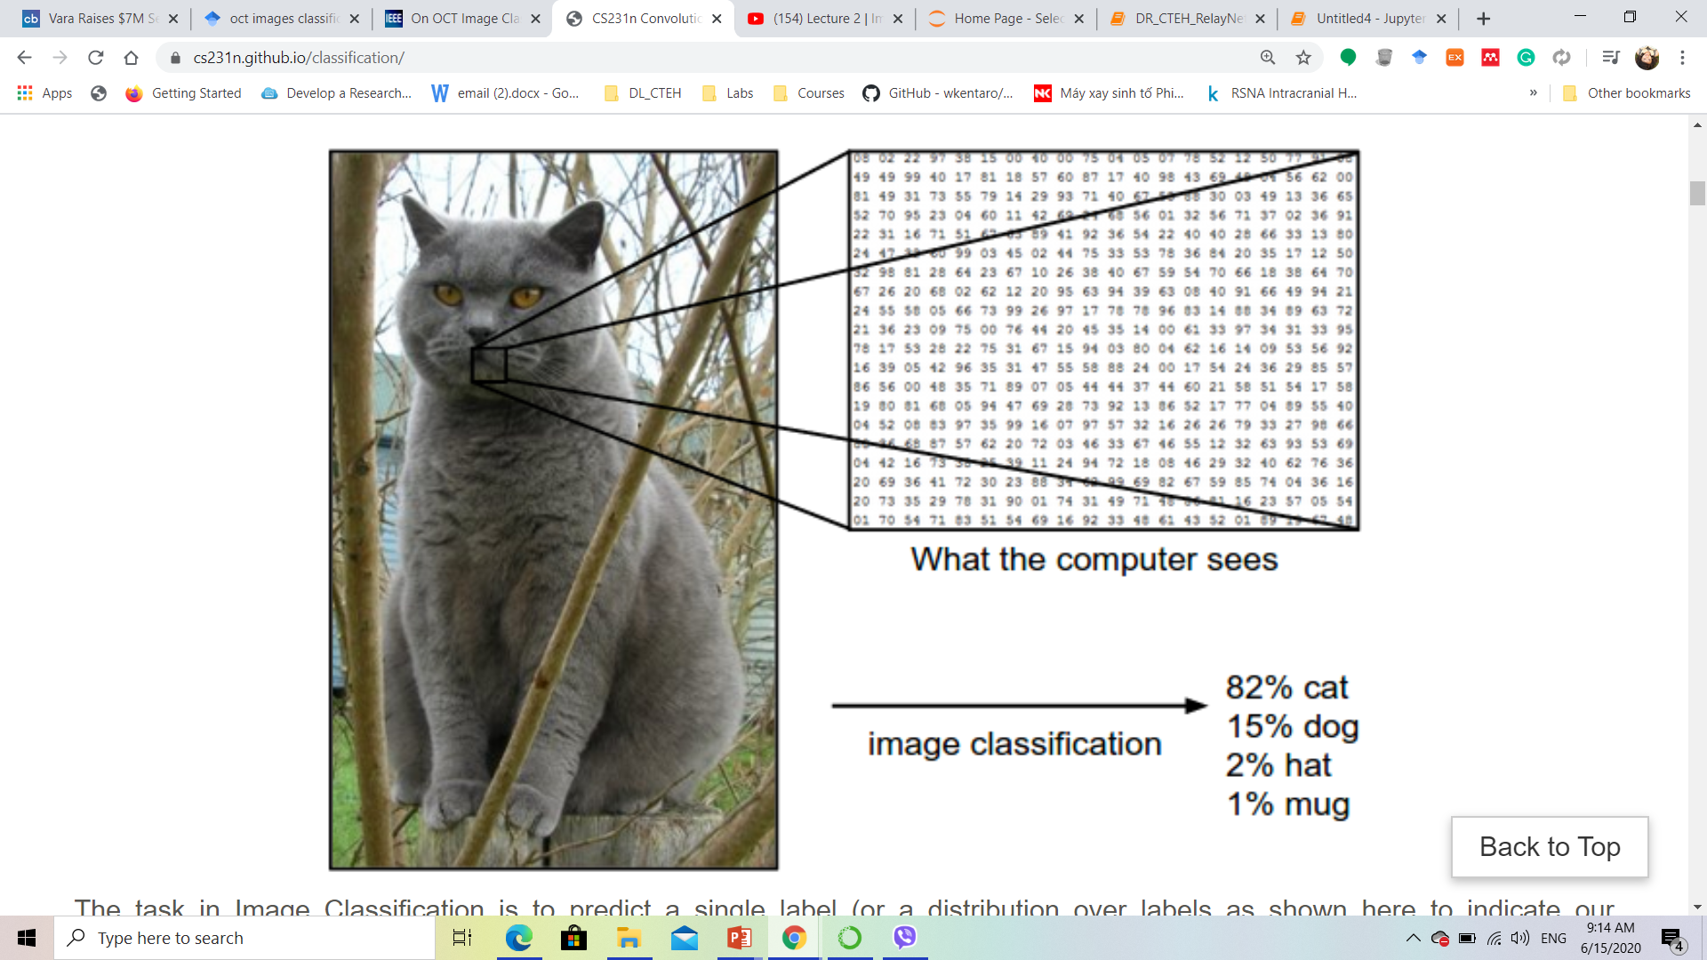
Deep Learning Applications
Classification
What the computer sees
Image classification
82% cat
18% non-cat

Slide 5
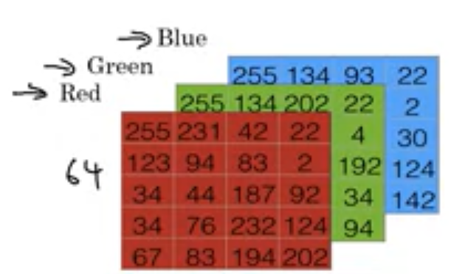
Binary Classification
An image is just a big grid of numbers between [0,255]:
e.g., 900 x 600 x 3 (3 channels RGB)
What the computer sees
Notes:
Gigantic grid of number including 3 channels representing red, green, and blue. So, normally if you have a good quality image of 1240x1240 pixels means that it has 1240x 1240x3 pixels in total. The value of each pixel is called intensity, in range of [0, 255]

Slide 6

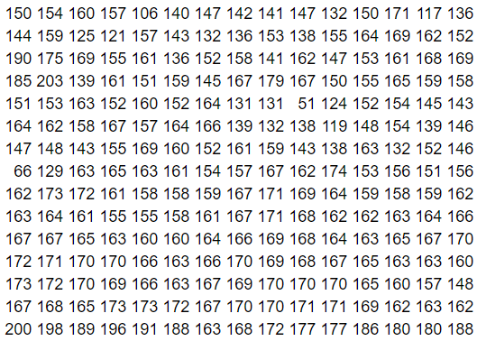
Pixel intensity

Slide 7
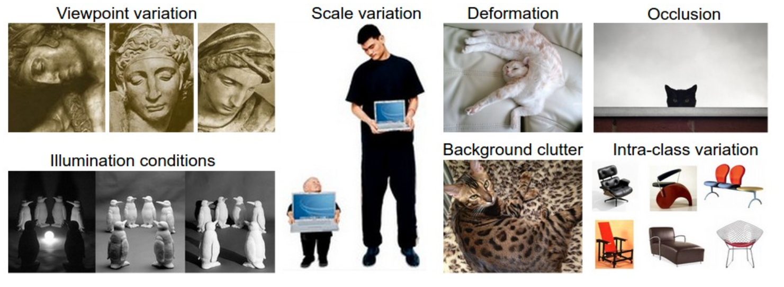
Challenges
Notes:
A good image classification model must be invariant to the cross product of all these variations, while simultaneously retaining sensitivity to the inter-class variations

Slide 8
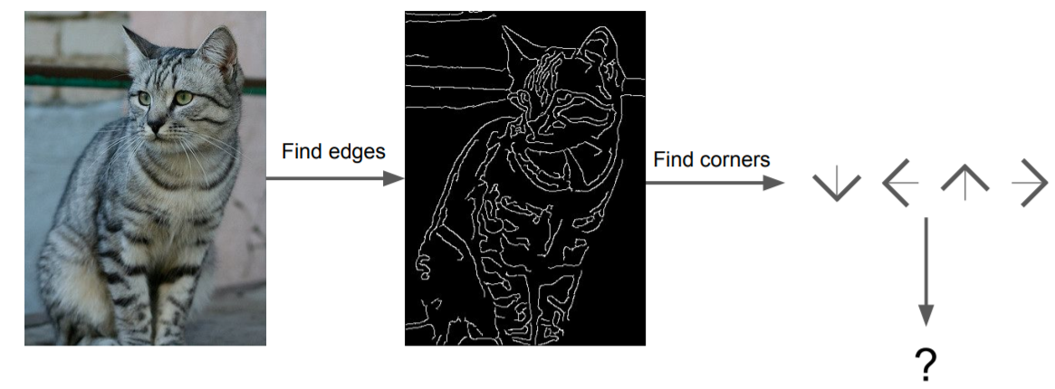
Attempts have been made
Fei-Fei Li et al. (cs231n.Stanford.edu)

Slide 9
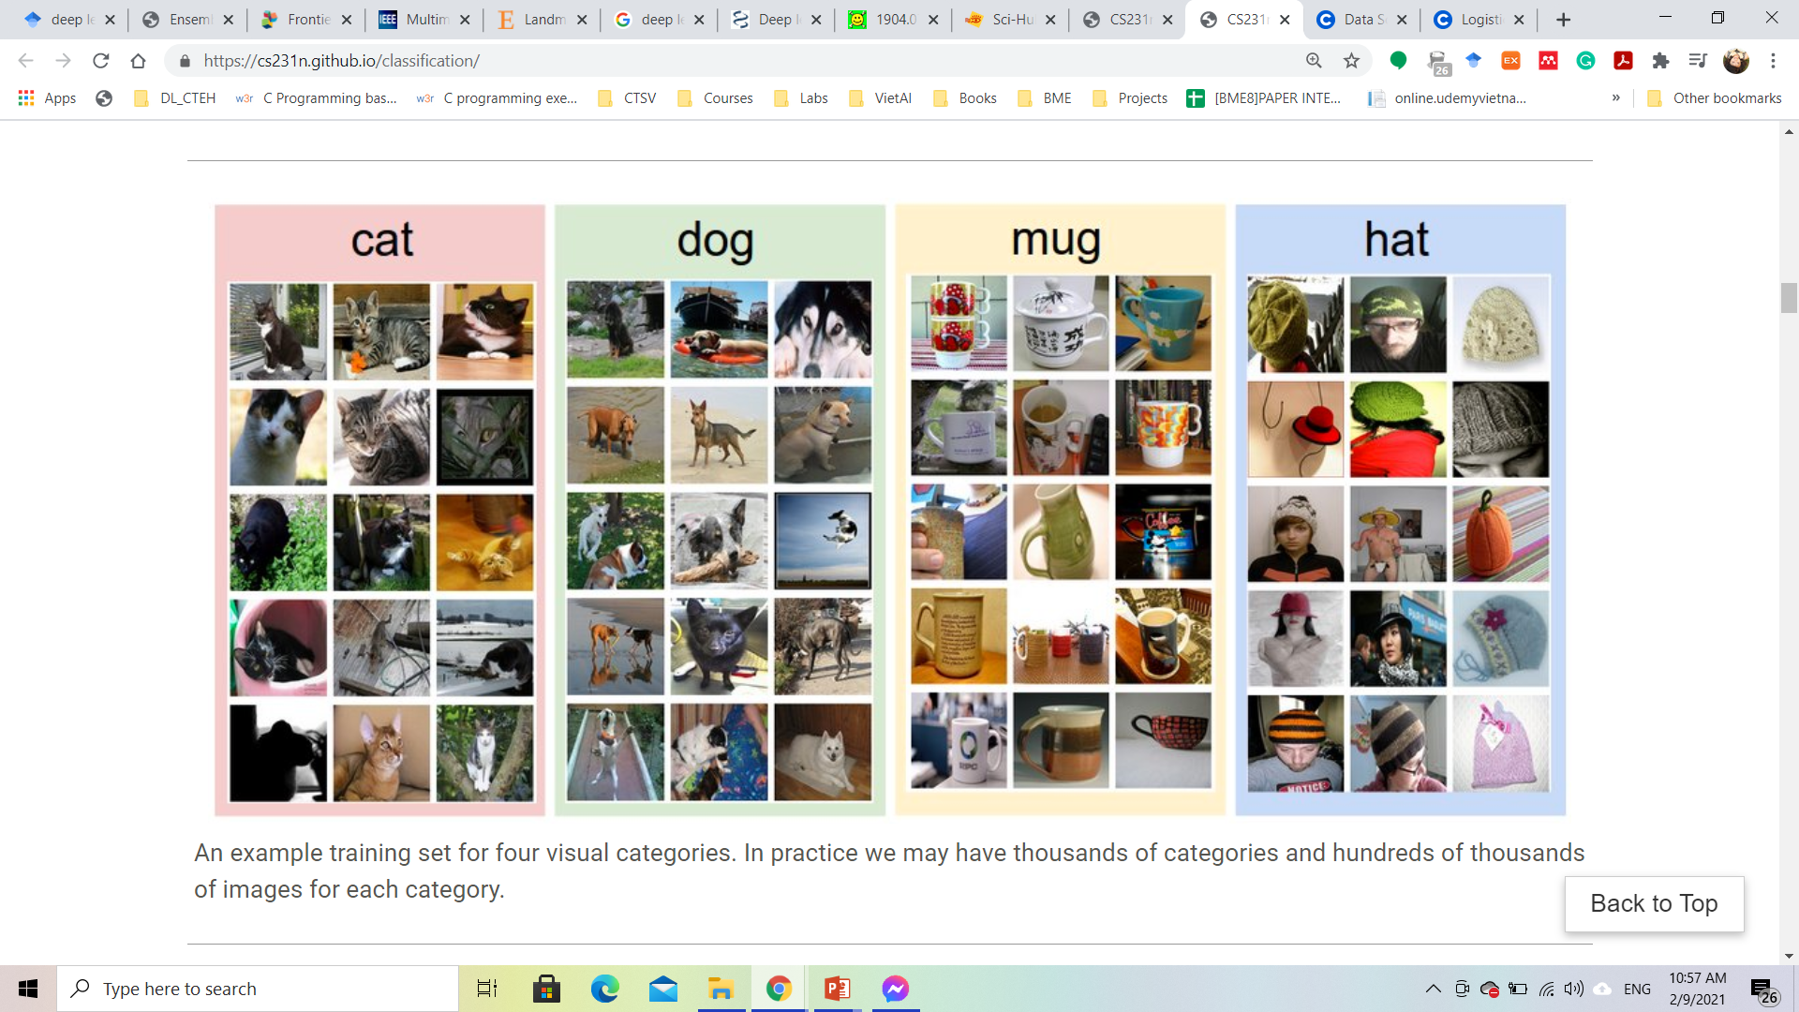
Data-driven approach
We’re going to provide the computer with many examples of each class and then develop learning algorithms that look at these examples and learn about the visual appearance of each class.

Slide 10
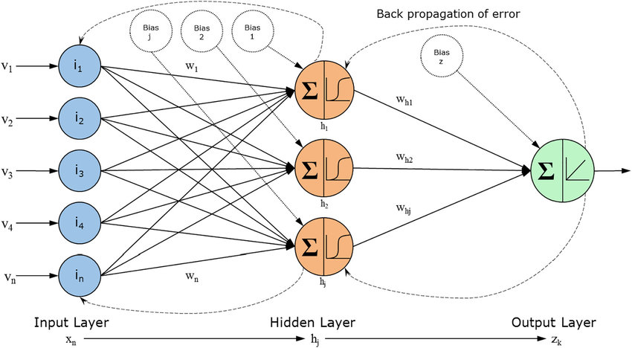
Data-driven approach
Output

Slide 11
Supervised vs. Unsupervised Learning
Train the machine using data which is well “labeled”.
The machine then predict unforeseen data in the same domain
Labeling is not easy
Challenge with huge data
Working with unlabeled data
Clustering data patterns
Unsupervised data finds all kind of unknown patterns in data
It is easier to get unlabeled data than labeled data
Better in case of huge data

Slide 12
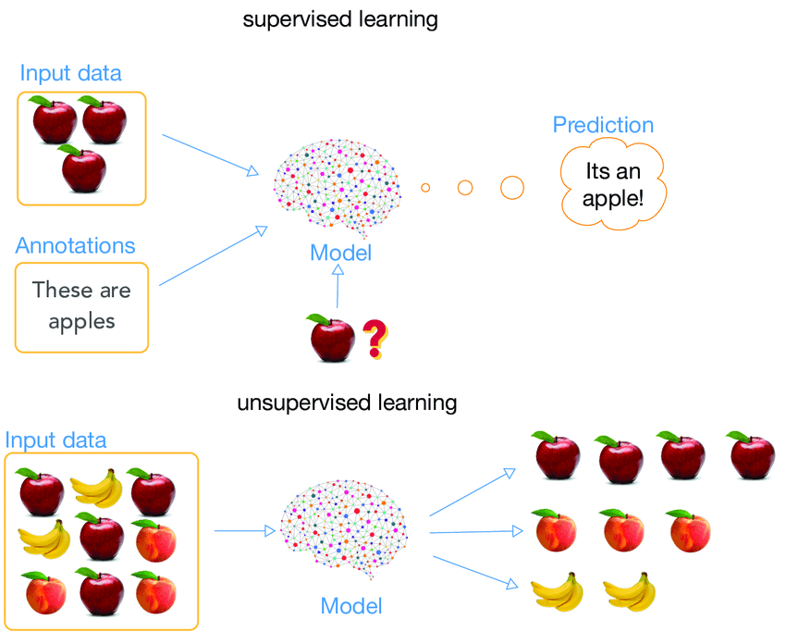
Supervised vs. Unsupervised Learning
Are the supervised and unsupervised learning a data-driven approach?

Slide 13


Slide 14
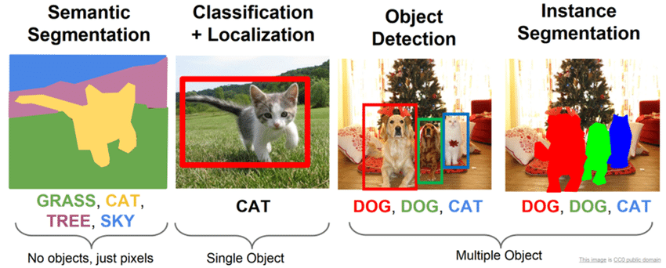
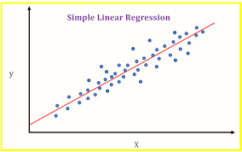
Supervised Learning
Classification:
Classification
Segmentation
Object detection
Regression

Slide 15
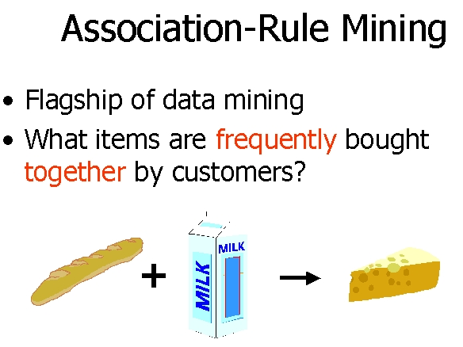
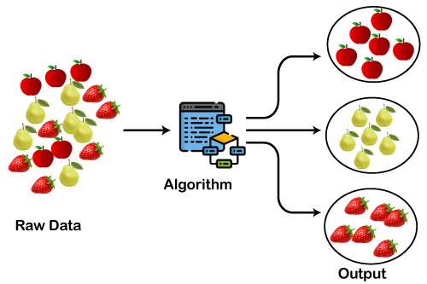
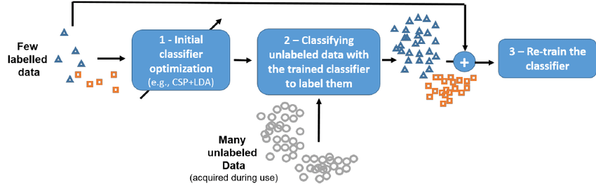
Unsupervised Learning
Clustering
Association
Semisupervised Learning

Slide 16
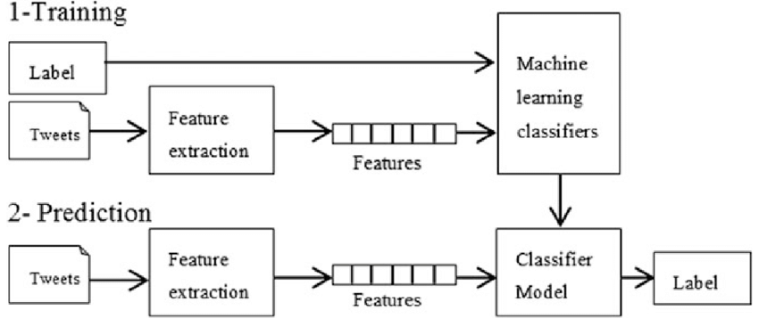
Training and Testing in Supervised Learning
Input
Input
Prediction

Slide 17
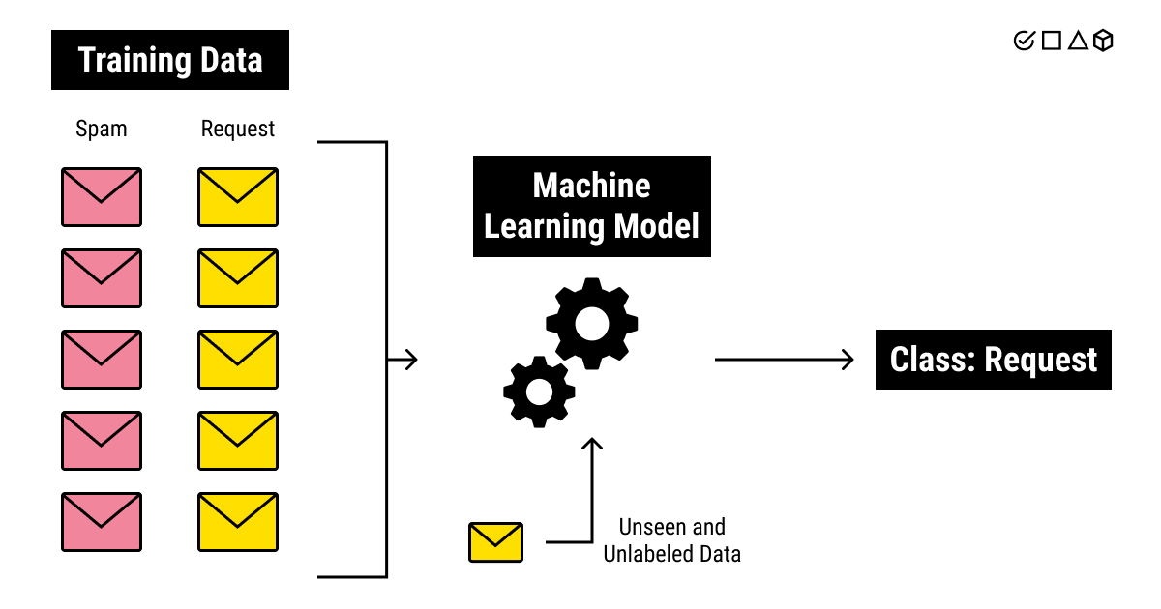
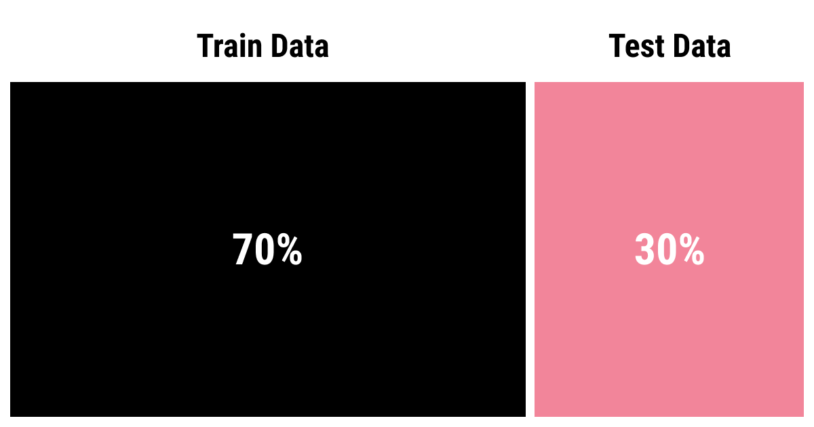
Training and Testing in Supervised Learning

Slide 18
Supervised Classification

Slide 19

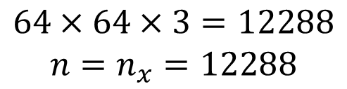
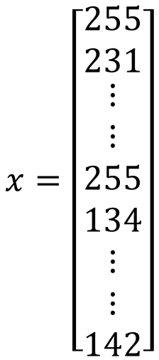
Binary Classification
1 (cat) vs 0 (non cat)
y
output
$$x=\left[\begin{matrix}255 \\ 231 \\ \begin{aligned}⋮ \\ ⋮ \\ 255 \\ 134 \\ ⋮ \\ ⋮ \\ 142\end{aligned}\end{matrix}\right]$$
x
input
$$64×64×3=12288$$
$$n=n_{x}=12288$$

Slide 20
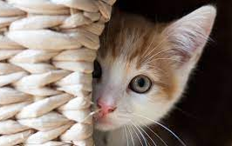

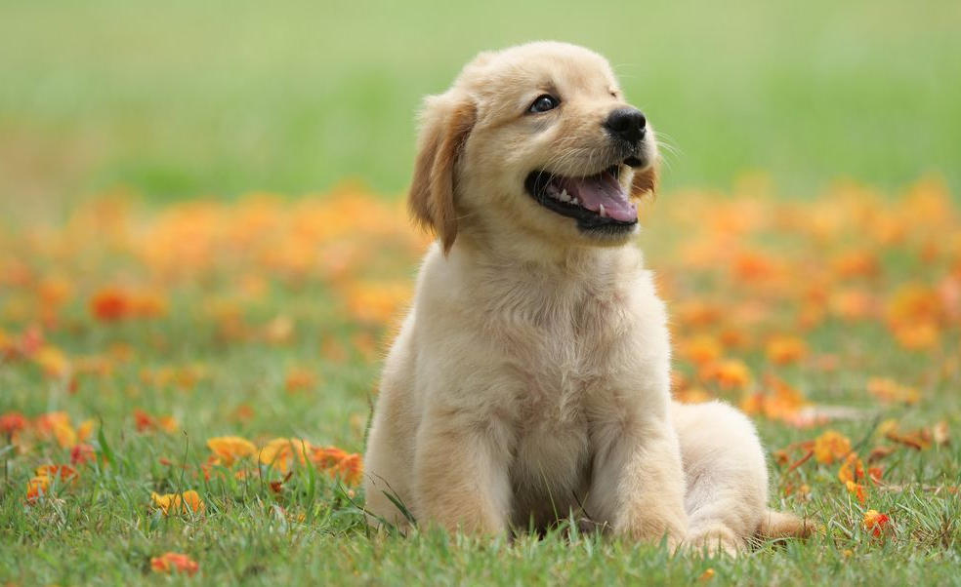
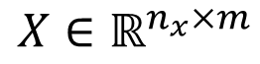
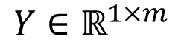
Binary Classification
X⁽¹⁾
y⁽¹⁾
…
Y = [y⁽¹⁾ y⁽²⁾ … y^{(m)}]
X = X⁽¹⁾ X⁽²⁾ X^{(m)}
X⁽²⁾
y⁽²⁾
$$Y∈ℝ^{1×m}$$
$$X∈ℝ^{n_{x}×m}$$
…
…
…
m training examples
(M_{train}, M_{test})
X^{(m)}
y^{(m)}

Slide 21
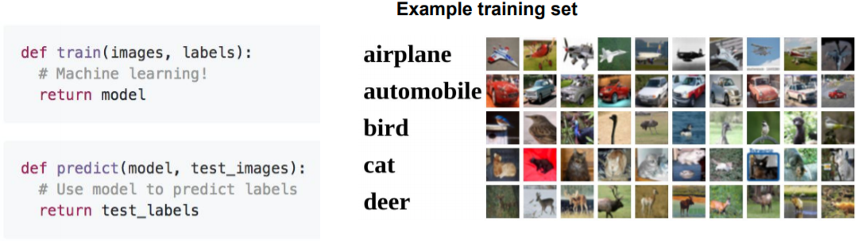
Multi-class Classifier
Data-driven approach:
Collect a dataset of images and labels
Use Machine Learning to train a classifier
Evaluate the classifier on new images

Slide 22

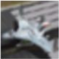

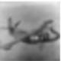

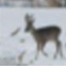
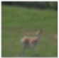

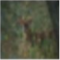
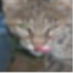
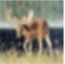


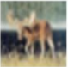
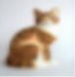
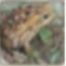
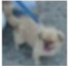
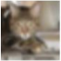
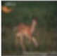
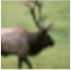
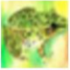




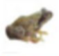
Nearest Neighbor
Class 1
Class 2
Class 3
Class 4 …

Slide 23
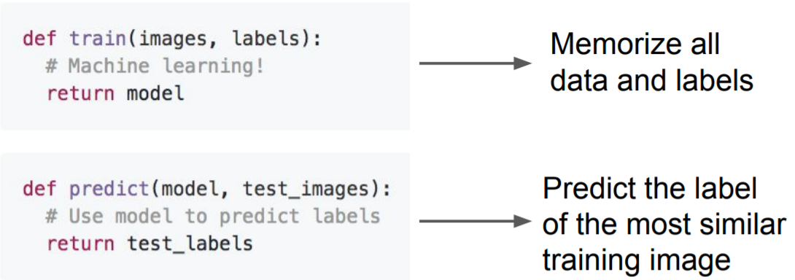
First classifier: Nearest Neighbor

Slide 24
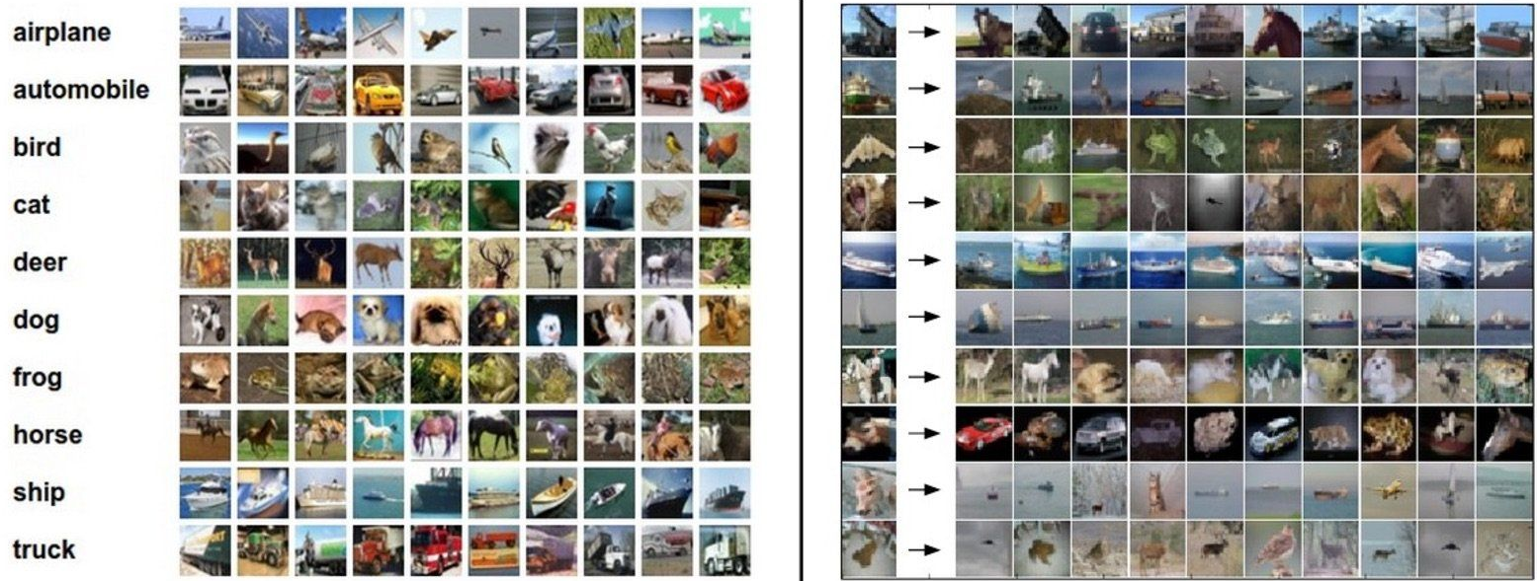
Example Dataset: CIFAR10
10 classes
50,000 training images
10,000 testing images Test images and nearest neighbors

Slide 25
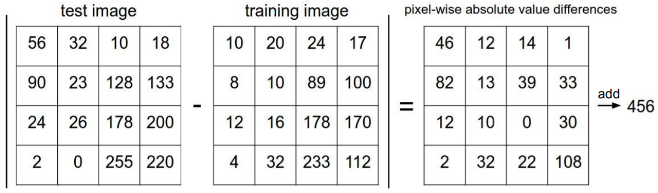
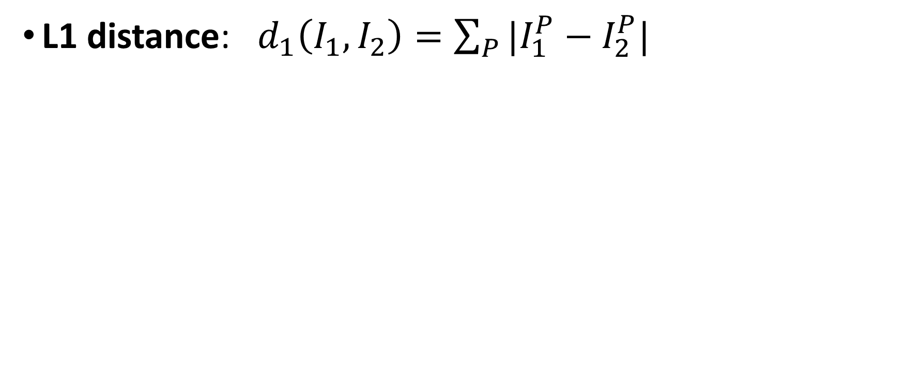
Distance Metric to compare images
L1 distance: $d_{1}\left(I_{1},I_{2}\right)=\sum_{P}{|I_{1}^{P}−I_{2}^{P}|}$

Slide 26
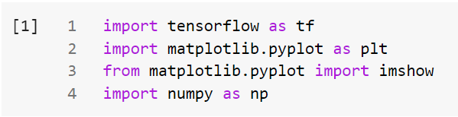


Slide 27
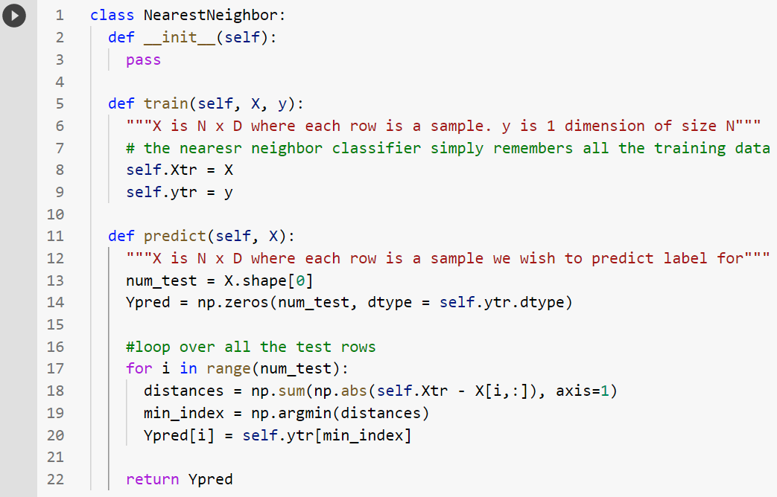
Nearest Neighbor Classifier

Slide 28
Nearest Neighbor Classifier
Memorize training data

Slide 29
For each test image:
Find closest train image
Get the same label of the nearest image

Slide 30
Problem:
Fast for training
Slow for prediction
We want classifiers that are fast at prediction, slow for training is ok.

Slide 31
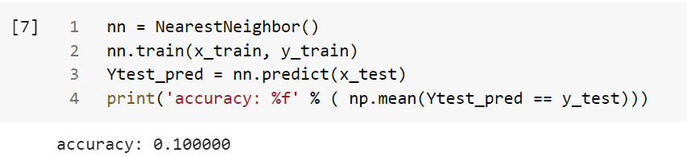
Prediction

Slide 32
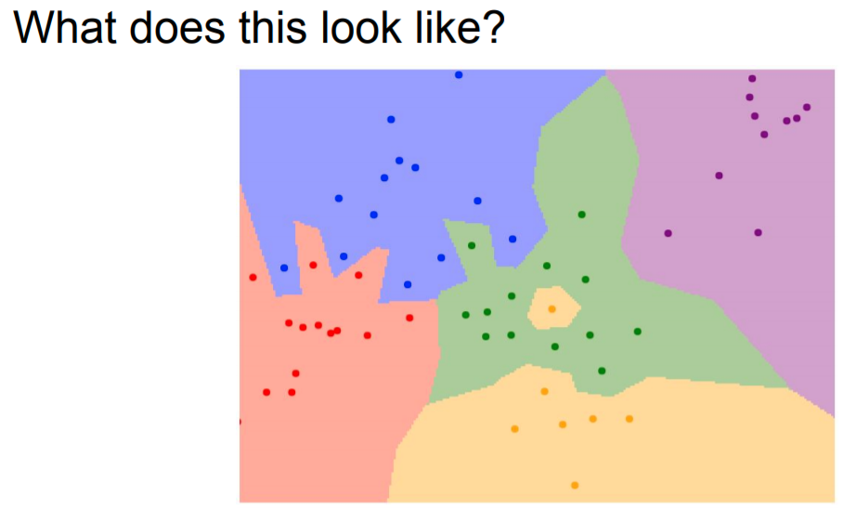

Slide 33
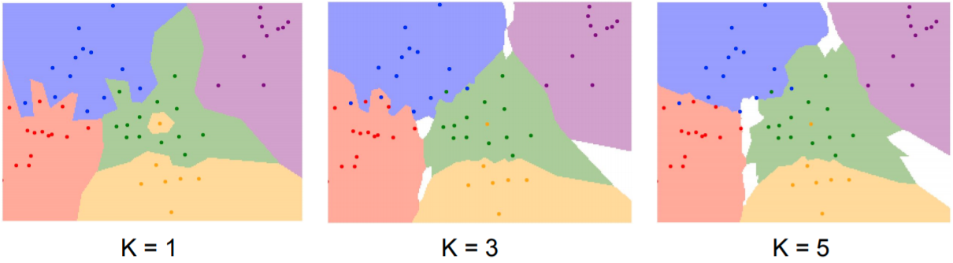
K-Nearest Neighbors (KNN)
Instead of copying label from nearest neighbor, take majority vote from K closest points

Slide 34
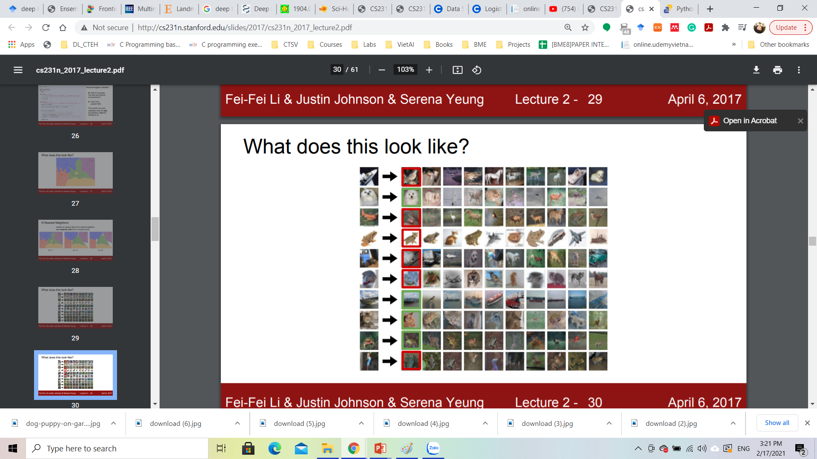

Slide 35

Setting hyperparameters

Slide 36

Setting hyperparameters
Usefull for small datasets, but not used too frequently in real-world problems

Slide 37
Pros and Cons
Pros:
Simple to implement and understand
Take no time to train
Cons:
Pay computational cost at test time
Bad choice in case of high-dimensional data since distances over high-dimensional spaces can be very counter-intuitive

Slide 38
Distances over high-dimensional space can be counter-intuitive

Slide 39
sklearn.neighbors.KNeighborsClassifier

Slide 40

Assignment
Applicable in some settings ( especially if the data is low-dimensional)

Slide 41
Assignment
Classify the MNIST dataset

